Slide 1

IoC and DI with Ninject
2 – Inversion of Control

Slide 2
IoC and DI with Ninject
2 – Inversion of Control

Slide 3
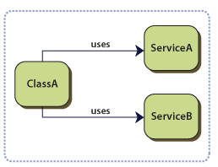
What is Inversion of Control?
A pattern of Dependency Management
Different types
Control over interfaces between two components
Control over the flow of an application
Control over dependency creation and binding

Slide 4
Forces
You want to decouple your classes from their dependencies so that the dependencies can be replaced or updated with minimal or no changes to your classes' source code.
You want to write classes that depend on classes whose concrete implementations are not known at compile time.
You want to test your classes in isolation, without using the dependencies.
You want to decouple your classes from being responsible for locating and managing the lifetime of dependencies.

Slide 5
IoC vs DIP
IoC is an implementation of DIP
Many implementations of IoC / DIP
Unity, Castle, Ninject, StructureMap, …
Flattening of hierarchy through interfaces
Removal of dependency on physical implementation
Rules engine for deciding
which implementations are used
And how object lifetimes are managed

Slide 6
Types of Control Inversion
Interface inversion
Flow inversion
Creation inversion

Slide 7
Interface Inversion
Basic rule: Move implementation behind interfaces
Don’t create an interface is there is only one implementation
There is a provider model that gives implementations
Allows substitution of implementation
User of a services does not know of any of the implementations
Hence, it is not in control. Control has been inverted to the provider

Slide 8

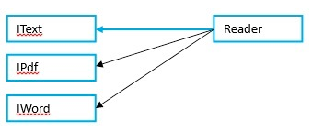
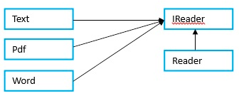
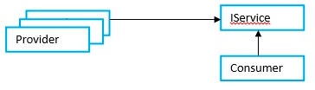
Sequence of Interface Inversion

Slide 9
Flow inversion
Procedural vs event driven programs
Command line vs GUI
Also, dynamic substitution of algorithms

Slide 10
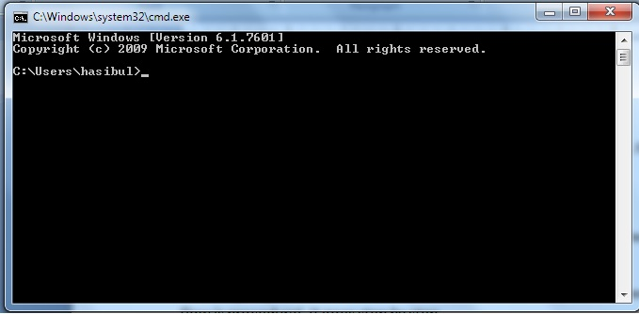
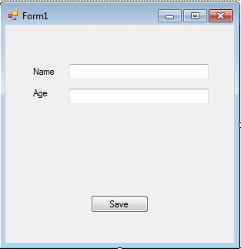
Command Line vs GUI

Slide 11
Creation inversion
This is the core of most .NET IoC containers
Get rid of “new” – new is evil
New needs to know implementation
You are now dependent
Creation of objects is inverted
It is created outside the using class
IoC container is an implementation of the Factory pattern
Except even the factory can be substituted

Slide 12
IoC implementations (1)
Factory pattern
In class-based programming, the factory method pattern is a creational pattern which uses factory methods to deal with the problem of creating objects without specifying the exactclass of object that will be created. This is done by creating objects via calling a factory method—either specified in an interface and implemented by child classes, or implemented in a base class and optionally overridden by derived classes—rather than by calling a constructor.
http://en.wikipedia.org/wiki/Factory_%28object-oriented_programming%29

Slide 13
IoC implementations (2)
Service Locator
The service locator pattern is a design pattern used in software development to encapsulate the processes involved in obtaining a service with a strong abstraction layer. This pattern uses a central registry known as the "service locator", which on request returns the information necessary to perform a certain task.^{[1]}
http://en.wikipedia.org/wiki/Service_locator_pattern

Slide 14
IoC Implementations (3)
Dependency Injection
In software engineering, dependency injection is a software design pattern that implements inversion of control for software libraries, where the caller delegates to an external framework the control flow of discovering and importing aservice or software module. Dependency injection allows a program design to follow the dependency inversion principle where modules are loosely coupled. With dependency injection, the client part of a program which uses a module or service doesn't need to know all its details, and typically the module can be replaced by another one of similar characteristics without altering the client.
An injection is the passing of a dependency (a service) to a dependent object (a client). The service is made part of the client's state. Passing the service to the client, rather than allowing a client to build or find the service, is the fundamental requirement of the pattern.
There are three common forms of dependency injection: setter-, interface- and constructor-based injection, where the responsibility of injecting the dependency lies upon the client, the service or the constructor method respectively.
http://en.wikipedia.org/wiki/Dependency_injection

Slide 15
Issues
My code still needs to “get” objects
I would prefer that I be given the objects so I don’t have to create them
This is solved by Injection – module 3

Slide 16
Summary
IoC lets us invert taking away the creation of objects
By using an interface we don’t need to worry about the implementation
Generally leverages factories
But even knowing about factories is too much knowledge

